Slide 1
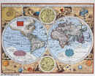
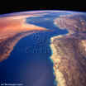
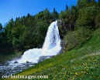
Landforms – A Trip Around The World
December 2012

Slide 2
How are people and landforms connected?
Using your personal knowledge write true or false for each statement.
1. The rock cycle is involved with the formation of landforms in Florida.
2. People’s actions can affect the formation of landforms in Florida.
3. People can make money from natural landforms.
4. Natural landforms are being made everyday in Florida
5. There is an unlimited supply of fresh water in Florida.

Slide 3
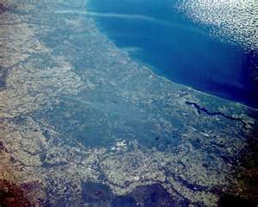
Florida Swamp
Definition: A freshwater wetland.
State: Florida
Facts: The land is often muddy and spongy. There are many trees and shrubs. There is a lot of aquatic life such as frogs and other amphibians.
Famous Landform: Everglades and Okefenokee Swamp

Slide 4
Delta
Definition: Low land formed at the mouth of a river.
State: Mississippi
Facts: Usually triangular in shape. Made by deposits of silt. Its name comes from the Greek alphabet.
Famous Landform: Kenai River Delta

Slide 5
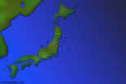
Archipelago
Definition: A group of many islands.
State: Hawaii
Facts: Found in a sea or ocean. Easiest landform to spot from space. Home to many types of aquatic wildlife (seals).
Famous Landform: Galapagos Islands

Slide 6
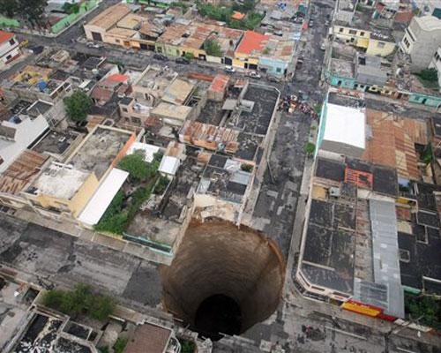
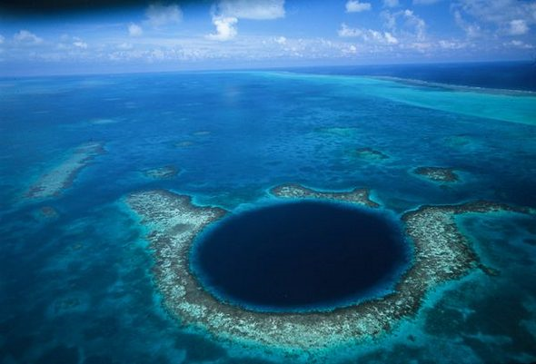
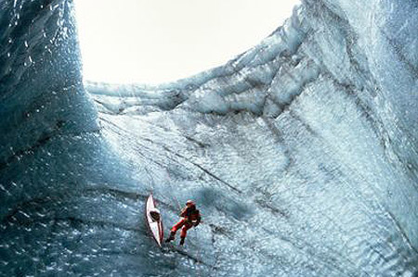
Sinkhole
Definition: A natural depression in a land surface formed by the dissolution and collapse of a cavern roof
State: Florida
Facts: Sinkholes are roughly funnel-shaped and on the order of tens of meters in size. They generally occur in limestone regions and are connected to subterranean passages
Famous Landform: Guatemala Sinkhole
Photo of:
Guatemala, Blue
Hole (Belize), Iceland

Slide 7
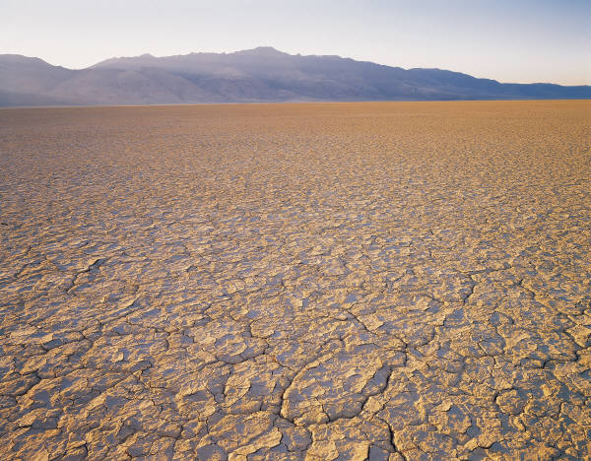
Winter park Sinkhole

Slide 8
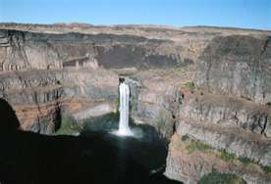
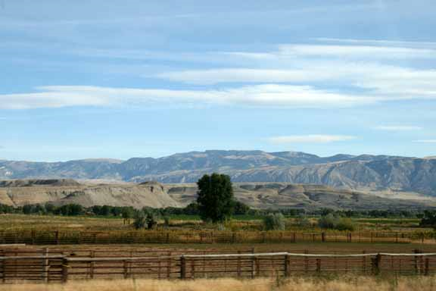
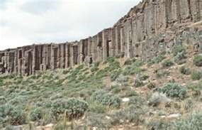
Plateau
Definition: High area of level land separated from the surrounding land.
State: Colorado
Facts: They cover 45 percent of the earth's surface. They can be formed by erosion or lava flows. Some plateaus are used for farming.
Famous Landform: Columbia Plateau
Photo of: Big Horn Plateau, and Columbia Plateau

Slide 9
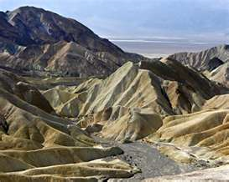
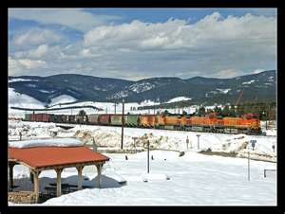
Valleys
Definition: A valley is a low place between mountains.
State: Nevada
Facts: Valleys run through plains, hills and mountains. They typically have a river or lake located at their base.
Valleys may be V-shaped or U-shaped.
Famous Landform: Death Valley, Rocky Mountain Valley, and Fraser Colorado Train Station

Slide 10
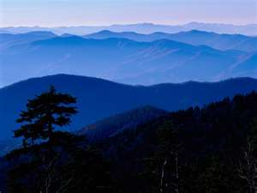
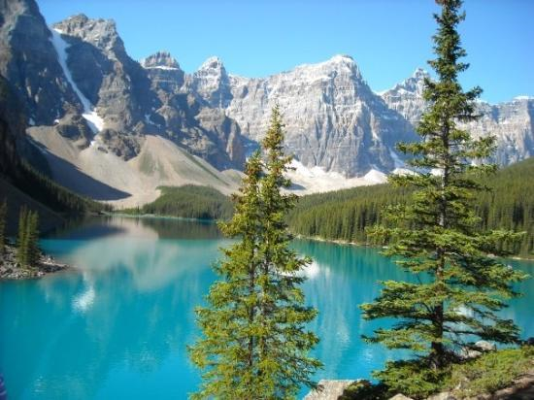
Mountains
Definition: Area of land that is taller than a hill
State: Colorado
Facts: Can be seen from space. Sharp peaks mean that the mountain is young. Round peaks mean that the mountain is old.
Famous Landform: Rocky Mountains
Photos of: Rocky Mountains, and Great Smoky Mountains

Slide 11
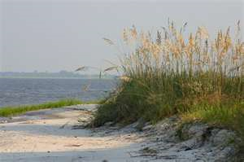
Plains
Definition: A broad flat area of land.
State: Kansas
Facts: They can be found along the coast or inland. Grasses or forest can cover plains. Plains are good for farming.
Famous Landform: Great Plains
Photos of: Great Plains and Florida Coastal Plains

Slide 12
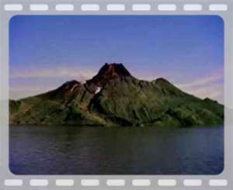
Volcano
Definition: A mountainous vent in the earth.
State: Hawaii
Facts: When a volcano erupts it spews lava, hot gasses, and ash. There are six different types of volcanoes. Volcanoes are active, dormant, or extinct.
Famous Landform: Mauna Loa

Slide 13
Glacier
Definition: Large area of ice that flows over the land.
State: Alaska
Facts: 75 percent of the world's fresh water is frozen in glaciers. Compacted layers of snow form glaciers. Many glaciers are melting due to a rise in temperature.
Famous Landform: Beordmore Glacier
Photo of: Greenland Glacier

Slide 14
Definition: A steep face of rock and soil State: Wyoming Facts: Cliffs are formed by erosion. Most cliffs can be found on coasts and mountains. The highest cliff in the world is 1340 miles high. Famous Landform: Devil's Tower
Cliff

Slide 15
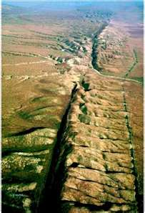
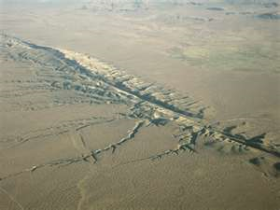
FAULTS
Definition: A large crack or fracture in rocks
State: California
Facts: Movements of faults cause earthquakes. The movement of rocks controls faults. There are three types of faults.
Famous Landform: San Andreas

Slide 16
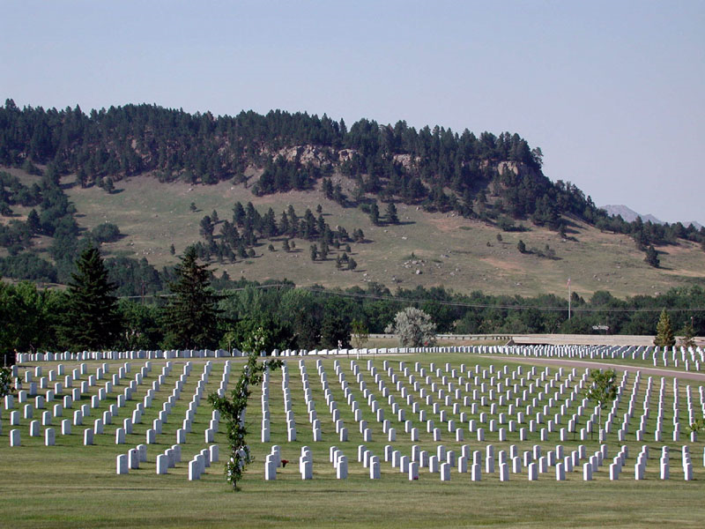
Hill
Definition: Area of land that is higher then the area around it.
State: South Dakota
Facts: Hills are formed by a buildup of rock debris. They can also be formed by Volcanic eruptions. You can find a hill in mountains, valleys, and plains.
Famous Landform: Black Hills
Photo of: Clermont Florida
Black Hills National Cemetary

Slide 17
Peninsula
Definition: Body of land surrounded by water on three sides.
State: Florida
Facts: Many peninsulas have a triangular shape. Some peninsulas have a broad base; others are narrow like an isthmus. The largest peninsula covers 1,000,000 miles.
Famous Landform: Balkan Peninsula
Photo of: Florida (taken by ISS)

