Slide 1
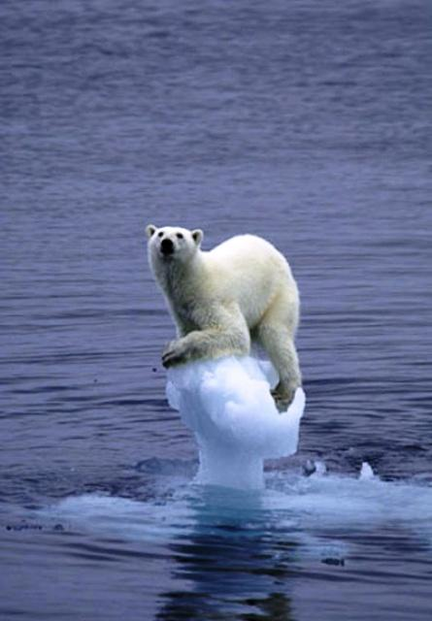
Human Impact
ABC Book
By Melissa Cole

Slide 2
A is for Acid Rain
Acid Rain is created by Coal burning plants that release Nitrogen Oxide and sulfur dioxide gas. These two gasses combine with Water vapor to create nitric acid and sulfuric acid that fall to the ground as acid rain. Acid rain affects plant growth and life in lakes and rivers. Marble statues are effected too!

Slide 3
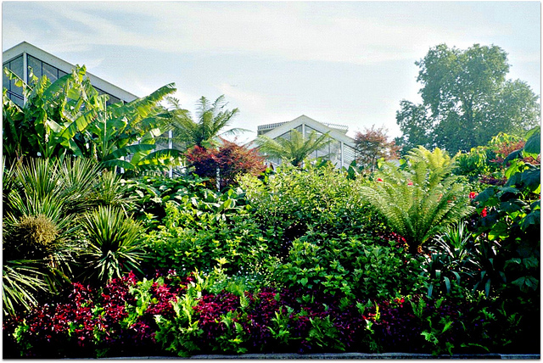
B is for Biodiversity
Biodiversity is the number of different organisms in a specific area. Rainforest and Coral reefs are areas with high biodiversity. Human activity such as logging and development along the coast has diminished biodiversity in these areas.

Slide 4
C is for Carbon Dioxide
Carbon dioxide is a natural gas in the atmosphere. Coal burning plants and automobile exhaust release carbon dioxide in the atmosphere. Carbon dioxide has been linked to global warming which is increasing the Earth’s temperature.

Slide 5
D is for Desertification
Desertification is the loss of vegetation in a dry land ecosystem due to climate and human activities.
Loss of vegetation can increase large dust clouds that can cause health problems.
Global warming is excepted to increase desertification in dry areas around the world.

Slide 6
E is for Erosion
Erosion is increased by human activities such as deforestation, leaving fields bare, development along the coast. Erosion can contribute to creating mudslides which have a devastating effect on neighborhoods that are in the path of mud slide.

Slide 7
F is for Farming
Farming can contribute to water pollution by fertilizer running off into nearby ponds and lakes. This creates excessive algae growth which can result in fish kills.

Slide 8
G is for Global Warming
Global warming is the term referring to the increasing average temperature of the Earth. An increase in greenhouse gases such as carbon dioxide and methane has been attributed to the increase in the Earth’s temperature.

Slide 9
H is Household Waste
Each year the average American throws away 1600 lbs. or 726 Kg of household waste a year. This waste is buried in landfills. Waste water from landfills leach into the water table and can pollute drinking water supplies.
Garbage produced in America alone could be lined up in garbage trucks from the Earth to the Moon!

Slide 10
I is for Industrial Waste
Industrial waste is the waste produced by a factory or business. If not properly disposed it can cause serious land and water pollution effecting communities as well as ecosystems!

Slide 11
J is for Joule
A Joule is a measure of energy.
The Earth receives 1370 joules per second everyday. If this energy was harnessed at the maximum rate there would be no need to burn coal or use other fossil fuels that pollute the environment.

Slide 12
Karst Topography
Karst topography is found in areas where the bedrock is made of limestone.
Karst topography refers to holes eroded in the limestone by slightly acidic water.
Sinkholes occur if the water table is lowered through drought or excess use water from the aquifer.

Slide 13
L is for Landfill
Landfills produce methane gas due to the anaerobic digestion of microbes on organic matter. This gas can contribute to greenhouse gases unless it used to generate electricity in a gas fired power plant

Slide 14
M is for Meter
Meter is the metric measurement for length.
Humans affect the first 50,000 meters of the atmosphere by emitting CFC that destroy the ozone layer and car emission that can add Ozone to the troposphere!

Slide 15
N is for Nitrogen
Nitrogen is an essential component in the cells of living organisms.
Fertilizer is high in nitrogen.
Storm water run off often has high levels of nitrogen from fertilizer applied to yards.
This nitrogen often creates Algae blooms that lead to fish kills!

Slide 16
O is for Ozone Layer
The ozone layer is located between the troposphere and the stratosphere.
It protects the planet from harmful UV rays.
CFC release in the air through aerosol cans and refrigerant once threaten to deplete the ozone layer. A global band on CFC has shown effective in combating this problem.
The ozone layer has signs of repair in recent years.

Slide 17
P is for Percolation
Percolation is the part of the water cycle where water moves through the soil to collect in the water table.
Water pollution can move through the soil also and pollute drinking water supplies.

Slide 18
Q is for Quicksand
Quicksand is super saturated soil where people and animals can get stuck and slowly get pulled down into the soil.
Increased rainfall due to global warming could increase areas of quicksand in ecosystems and potentially communites!

Slide 19
R is for Radioactive Waste
Nuclear power provides clean energy but it has one drawback.
Radioactive Waste is the byproduct of nuclear fission. It is difficult to dispose of safely because it radioactive for millions of years.
Radioactive waste is stored in old salt mines. It hard to find a suitable location because no community wants to store it.
(Not in my backyard)

Slide 20
S is for sea level rise
Sea level rise is the result of the melting of the ice caps due to the rise in temperature of the Earth.
Many of the low lying coastal areas could be covered by the sea. In North America the Florida coast, Gulf coast and West coast would be effected.

Slide 21
T is for temperature
The Earth’s average temperature has been rising steadily for the last 100 years.
The average temperature of the Earth is 61 degrees F
The average surface temperature of the Earth has risen 33.4 degrees since the 1880’s

Slide 22
U is for Urbanization
Urbanization is the building of cities and houses.
Urban areas have more run off due to roads and sidewalks allowing pollution to collect in nearby streams and rivers.
Urban areas are also responsible for habitat loss for many animal species.

Slide 23
V is for Vapor
Water vapor is essential for the continuation of the water cycle. Water is recycled through evaporation that forms water vapor in the air.
Water vapor is also considered a green house gas and contributes to global warming!

Slide 24
W is for Water cycle
The water cycle is essential for all life on Earth. It the process in which fresh water is recycled.
Global warming may affect the water cycle by increasing evaporation rates which will increase precipitation in some parts of the world while others will have a decrease in the amount of precipitation received in that area.

Slide 25
X is for Xenops
The Xenops is a bird that lives in the South American rainforest.
In the past 40 years close to 20% of the rain forest has been cut down more acres than the last 450 years.
At this rate of deforestation birds like the Xenops will not have a habitat to live in.

Slide 26
Y is for Yellowstone Park
Yellowstone and other national parks are one our most precious resources.
Acid rain, water pollution and global warming endanger our parks.
We must take action to reduce these potential pollutants to ensure that future generations will enjoy these pristine areas!

Slide 27
Z is for Zooxanthellae Algae
Zooxanthelle algae lives inside coral. It has a symbiotic relationship with the coral.
The algae make food through photosynthesis and the coral provides a home for the algae.
Increasing ocean temperatures have led to coral bleaching where the algae leaves the coral. The coral eventually dies without the algae.
Ocean temperature increase is due to global warming.

