Slide 1
History of the Sneaker
http://www.factmonster.com/ipka/A0932723.html

Slide 2
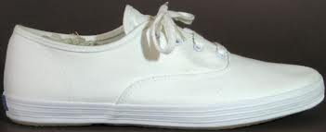
Original sneaker

Slide 3
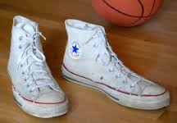
High Top Sneakers

Slide 4
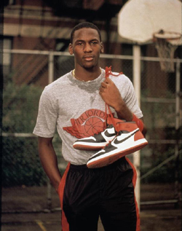
Michael Jordan High Tops

Slide 5
Need for Cross Trainers

Slide 6
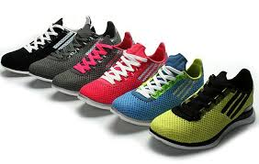
Cross Trainers

Slide 7
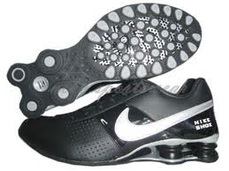
Shockabsorbers

Slide 8
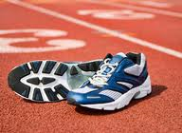
Shoes with shock absorber on Sole

Slide 9
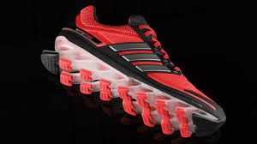
Maximum Shock Absorber

Slide 10
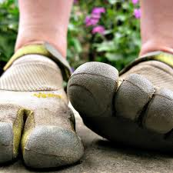
Shoes with Toes!

Slide 11
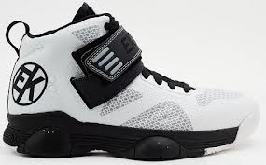
High tops with Shockabsorbers

Slide 12
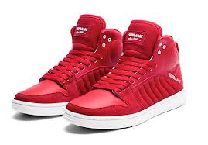
High tech shoes

Slide 13
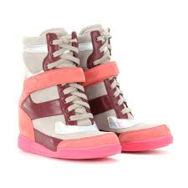

Slide 14
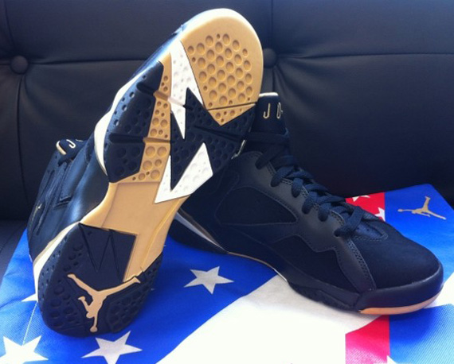
Michael Jordan High Techs

Slide 15
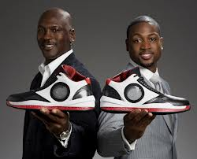
Showing off Shoes

Slide 16
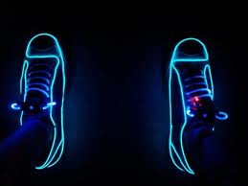
Glow in Dark Shoes

Slide 17
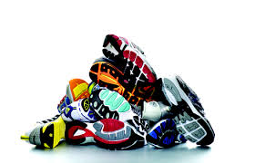
Modern Shoes

Slide 18
Homework
Science is Durable Homework
Due by September 10th
After viewing the evolution of the sneaker, create your own slideshow/pamphlet or other visual ( poster, etc.) of the durability of another everyday object that has changed through time.

